Slide 1

School of Computing
Vel Tech Rangarajan Dr. Sagunthala R&D Institute of Science and Technology
Department of Computer Science and Engineering
10211CS224 / FULL STACK APPLICATION DEVELOPMENT (JAVA)
PROJECT REVIEW : MILESTONE PROJECT – 1
Date: 22-04-2026
React JS Based Ticket Booking Web Application for Internal Department Event
SDG: SDG 4 – Quality Education | SDG 9 – Industry, Innovation and Infrastructure
Presented By:
CH.Venkata Susmitha – VTU26480 – 23UECS0135.
Courses Handling Faculty:
Dr.M.Mageshwari

Slide 2
INTRODUCTION
Ticket booking for department events is usually manual, causing errors, overbooking, and poor user experience.
A digital system is needed for students and faculty to view event details and book tickets conveniently online.
This project builds a React JS web application for Internal Department Event Ticket Booking.
The system provides real-time ticket availability, online booking with form validation, and instant booking confirmation.
Core React concepts used: functional components, JSX, useState hook, event handling, and conditional rendering.
1
2
3
4
5
6
7
8
9

Slide 3
PROBLEM STATEMENT
1
Manual ticket booking for department events causes overbooking, errors, and poor user experience.
There is no centralized platform for students and faculty to view event details and book tickets online.
Without a digital system, available ticket count cannot be tracked in real-time, leading to confusion.
A validated, real-time React JS web application is needed to streamline the event ticket booking process.
The system must handle input validation, prevent overbooking, and show booking confirmation to the user.
2
3
4
5
6
7
8
9

Slide 4
OBJECTIVE(S)
1
To design and develop a React JS based web application that allows students and faculty to view event details and book tickets online with real-time availability.
To implement form validation, error handling, and booking confirmation features that ensure a smooth and accurate ticket booking experience.
To apply React concepts such as functional components, useState hook, conditional rendering, and event handling in building the application.
2
3
4
5
6
7
8
9

Slide 5
PROPOSED SYSTEM
1
A React JS Single Page Application (SPA) that displays event details and allows users to book tickets online.
Event Details Module: Shows event name, department, date & time, venue, ticket price, and available seats.
Ticket Booking Module: Collects user name, email, department, and number of tickets with full validation.
Real-time ticket count update: Available tickets decrease automatically after each successful booking.
Booking confirmation summary displayed after successful booking with user name, event, tickets, and total amount.
Error handling: Prevents overbooking, validates email format, and shows user-friendly error messages.
2
3
4
5
6
7
8
9

Slide 6
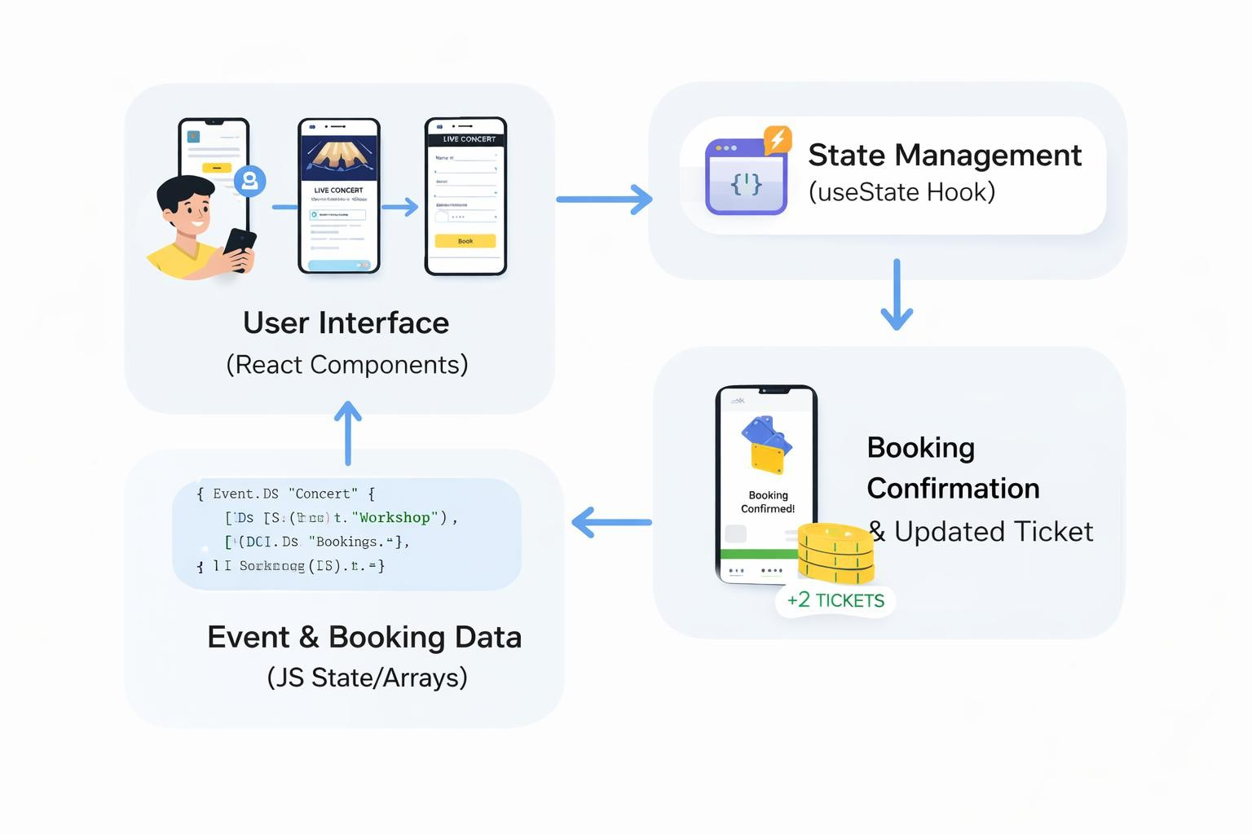
PROPOSED SYSTEM ARCHITECTURE
1
2
3
4
5
6
7
8
9

Slide 7
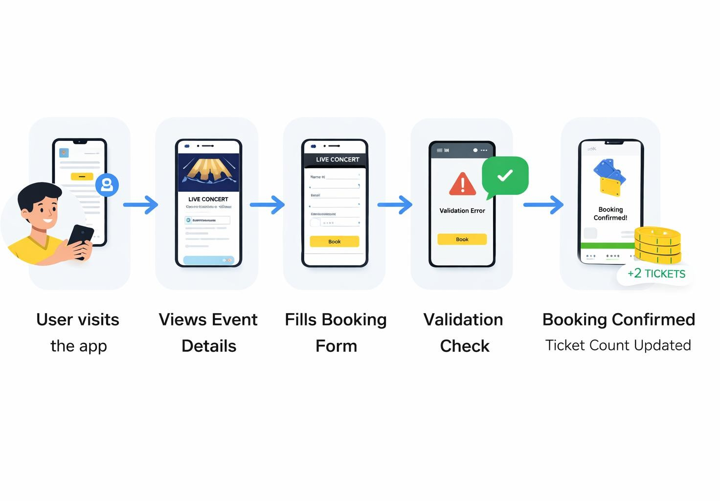
WORKFLOW
1
2
3
4
5
6
7
8
9

Slide 8
TECHNOLOGIES USED
Frontend: React JS (Functional Components, JSX, useState Hook, Event Handling)
Backend: Not applicable (Client-side only React application)
Database: JavaScript State Management (in-memory state using useState)
Tools: VS Code, Node.js, npm, Create React App / Vite
Requirements: Any modern browser (Chrome/Firefox), Windows/Linux/Mac OS
1
2
3
4
5
6
7
8
9

Slide 9
Module 1: Event Details Module
Displays event name, department, date & time, venue, ticket price, and available ticket count to the user.
Module 2: Ticket Booking Module
Accepts user name, email ID, department, and number of tickets. Validates all inputs before booking.
Module 3: Validation & Error Handling Module
Validates mandatory fields, email format, positive ticket count, and prevents overbooking with clear error messages.
Module 4: Booking Confirmation Module
Displays booking summary with user name, event name, number of tickets, and total amount after successful booking.

Slide 10
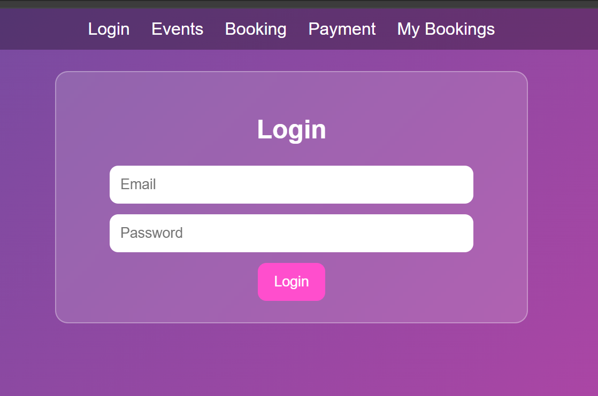
IMPLEMENTATION SCREENSHOTS
1
2
3
4
5
6
7
8
9

Slide 11
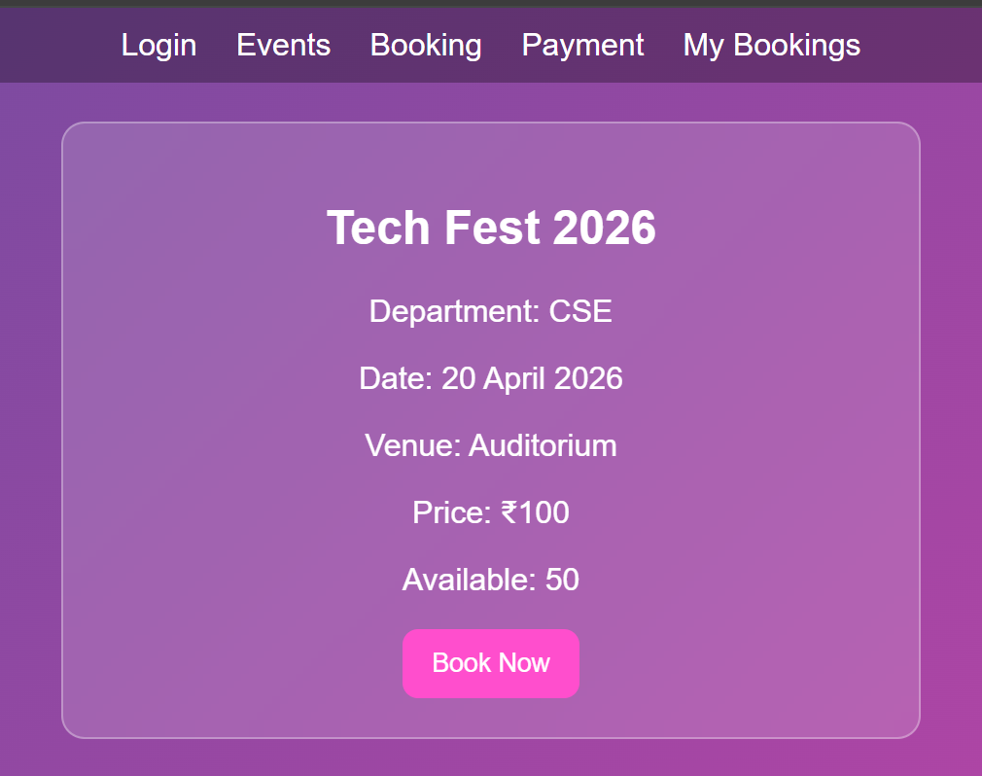
IMPLEMENTATION SCREENSHOTS
1
2
3
4
5
6
7
8(A)
9

Slide 12
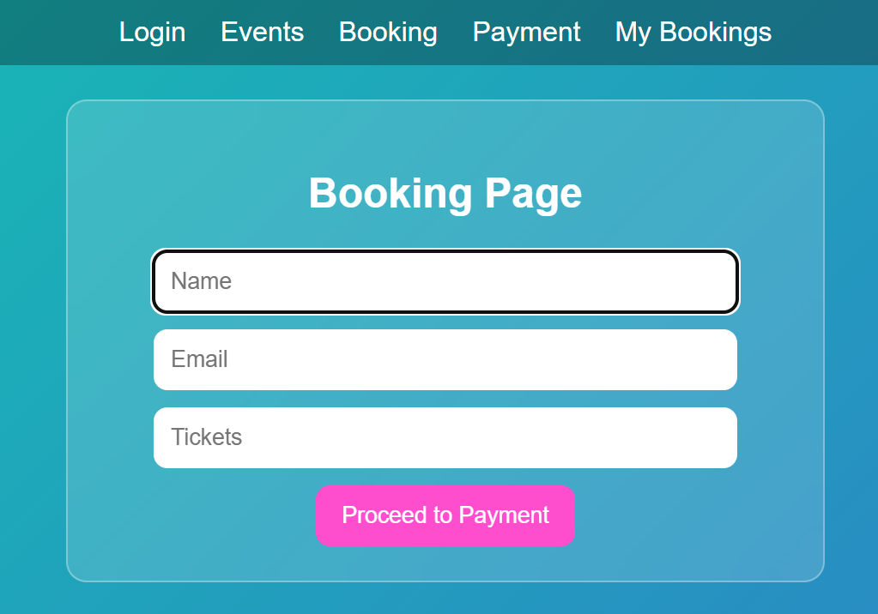
IMPLEMENTATION SCREENSHOTS
1
2
3
4
5
6
7
8(B)
9

Slide 13
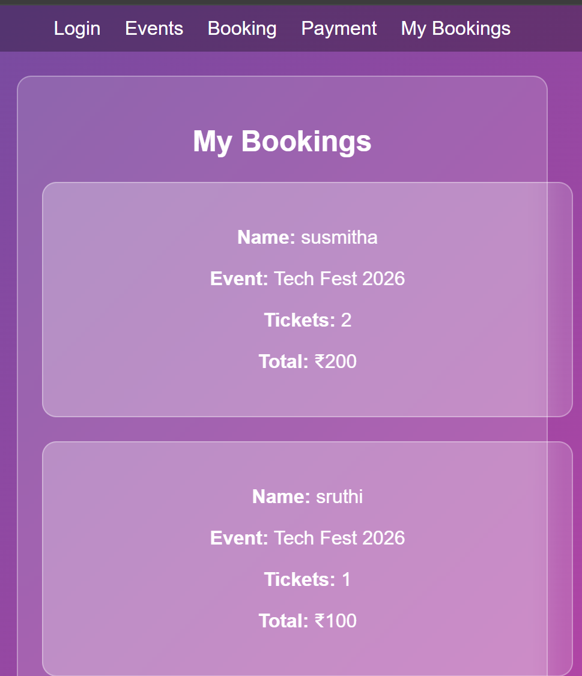
IMPLEMENTATION SCREENSHOTS
1
2
3
4
5
6
7
8(C)
9

Slide 14
ADVANTAGES & LIMITATIONS
Advantages:
Simple and user-friendly interface for booking tickets w¹ithout manual forms.
Real-time ticket availability updates prevent overbooking automatically.
In₃stant booking confirmation with a detailed summary for users.
R4esponsive design works on desktop and mobiles
1
2
3
4
5
6
7
8
Limit⁵ations:
N₆o backend or database - booking data is lost on page refresh (client-side only).
N7o user authentication - any user can book without login verification.
P⁸ayment integration is not included in the current version.
9
9

Slide 15
Thank you

